Slide 1
Annalect (US) MMM framework
US Marketing Science team

Slide 2
Wish list of the model platform
The design should be Intuitive and straightforward.
Reproducible : (past) model results (coefs, decomp, response curves, and ROI) can be easily reproduced.
Flexible :
Can be used across different clients and countries.
Model refresh with new data can be easily done with minor setups.
New functionality can be easily added into the existing structure of the platform.
Backward compatible
Modular:
The code should be written in an object-oriented way.
Each R function/module does one specific task. It should be written as generic as possible so that it can be easily used across different projects, and at different part of the model stage. For example, transform.R can be called pre-model stage and at the simulation stage.
More functionalities and capabilities can be easily added. For example, new transformations and new visuals.

Slide 3
MMM workflow and Marketing Science MMM Platform (msmp) high level structure
Data Process (3-6 weeks)
Model Process (3-6 weeks)
Post-model (Insights) Process (2-3 weeks)
Exploration
Data analysis
Decomposition & Unnest
Import data
Data Review (Process and Validate)
Variable Transform
Iterative Process
Simulation (response curve)
Optimization (channel planner)
Model (national or geo level model)
M
Compile model results into a workbook
Predict/forecast using new data
The model and post modeling process are done in Annalect’s MSMP environment programmed in R language
A system/model object (a list object) is created at the very beginning of the model process.
It ties the whole work-flow together: as modeler go from one modeling phase to the next, the model object from the previous phase contains all the information modeler needs to
At the end of the model, we have a model object that has data, model equation/specification, coefficients, model fit, decomposition, response curves and etc.

Slide 4
MMM process is a collaborative and an iterative process.
Collaborative : MMM project owners should work with media agency who executes and plans the media. They are great resource on what, why and how media were executed, this information is very useful in model building.
Iterative model process :
Validate model using metrics such as adjusted R2, MAPE, VIF, Durbin-Watson, residual trend.
Monitor ROI/contribution and mROI (diminishing returns) during the modeling process.
For certain MMM projects that are ongoing, new data already start to come in during the model process, this new data can be used to validate the model by comparing the prediction with the actualized the KPIs (out-sample validation).
At the end of the model process, the model results and insights are shared with not only the client but also the media agency.
Media partner will use this result for media budget planning.
Setup and run experiments (A/B test or geo level test). This experiment not only further validate the MMM results, but can be source of informative priors for next round of MMM.

Slide 5
Variable transformations

Slide 6
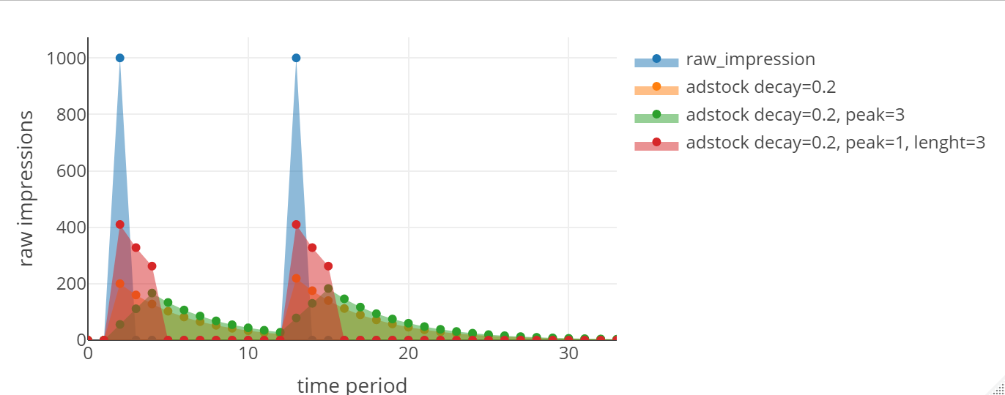
adstock : prolonged or lagged effect
R function adstockv3(afGRPs, fdecayRate, peak, length)
Description : adstock transform a media variable : linear built-up to the peak and geometric decay up to length
Arguments : afGRPs : numeric vector of media metrics (GRPs, impressions, or spend etc).
fdecayRate : a positive number with value between 0 and 1 that defines adstock decay rate.
peak : positive integer from 1 to length, default is 1.
length : positive integer from peak. The length
Note : the returned transformation is normalized. i.e. if you have 10k raw impressions, this function returns 10k adstocked impressions.

Slide 7

Diminishing return transformation
log(x*scale + 1) : natural log
abc function : $\frac{a}{1+{\left(\frac{x}{b}\right)}^{c} }$ a default value is 1.
adr : ad response transformation (see next page for details)
Note : the codebase also allows atan and power transformations.

Slide 8
adr (AdResponse transformation)
E = Effective Frequency How many exposures does the average person need to be affected by the ad? expressed as 1+ or 2+ or 3+ or 6+…
R = Recency Frequency How many of these exposures need to be recent? needs to be <= E
P = Period What does recent mean?
in # of days (will be in increments of 7 in almost all cases)
D = Decay Once exposed, how quickly do they forget?
expressed in % (similar to traditional adstock)
Example E3R1P21D20%
translation – 3 or more exposures, of which at least 1 needs to be within 21 days, and 20% of people exposed will forget the ad each week
Note, this transformation requires reach and frequency curves for the media channel.

Slide 9
Other frequently transformations modelers use often in models
Moving average | Usually used on time-series data to smooth out short-term fluctuation to highlight long-term trend or cycles
lag | Often used to account for delayed effect
Mean center | Commonly used in pooled models (panel models) where values of variables are very different across panels/geo/nameplates.

Slide 10
The MMM R code framework
(msmp – marketing science model platform)
Notes:
Not a creative and exciting name. I am open for suggestions.

Slide 11
msmp R functions
The common R functions that can be used across clients/projects
Transform.R (this R code contains all the definition of all the transformations)
Run_Model.R (runs myBayes.R – the Bayesian regression function)
Run_Model_Panel.R
Decomp.R
UnnestrR
ResponseCurve.R
Etc.
Each function takes in a model object, picks what it needs, performs its functionality, updates and returns the object -> flexible and modular

Slide 12
MMM project (data and code) organization and workflow
Each model resides in a model folder. It contains
_ModelData.csv : model ready data file. The file should contain all the raw variables (depvar, potential independent variables, and time variables).
_ModelSetup.csv : model-level parameters. For example, log-log model, BeginDate, EndDate, etc.
_Variable.csv : model specification at variable level. List of variables in the model, how to transform them, etc.
_FitCurves.csv (optional) : reach curve data
A R code that sources all the common functions, reads in the input files, run the MMM model process and write out the results (coef, decomp, model object etc.)
This framework ensures model result reproducibility and documentation. The _Variable.csv tells you everything about the model specification and can be shared and understood by anyone with excel.
Modelers with strong MMM experience but little R skills can easily get on

Slide 13
The outputs of the msmp framework

Slide 14
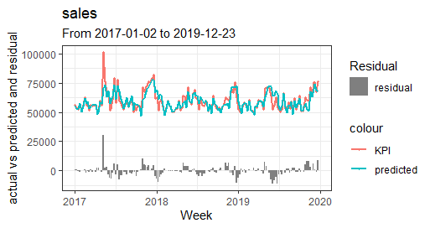
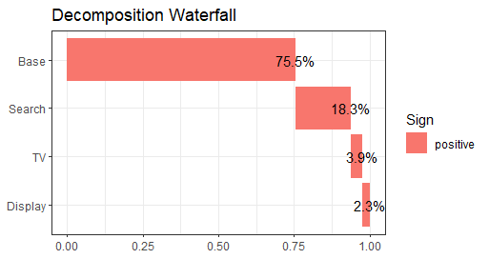
Msmp codebase output
The R code generates a list object that contains everything you need to perform model diagnostic, generate model outputs (tables and visuals), and do post-model calculations.
The scopes/requirements can be quite different from client project to project The model objects allows users to easily customize to their own needs per scope.
The codebase already has a range of functions that create standard tables and visuals.
For modelers who prefer excel, the R code produces excel workbook that contains everything they want to have in the workbook.

Slide 15
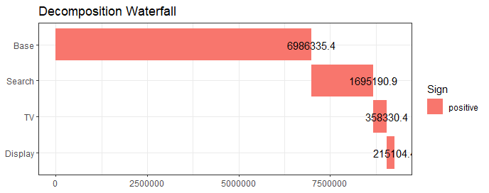
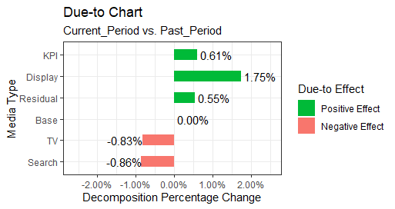
Some plots

Slide 16

Marketing Response Curves
MROI $=\frac{{Revenue}_{2}−{Revenue}_{1}}{{Spend}_{2}−{Spend}_{1}}$
Once the model is built, response curves can be generated using simulation at post-model phase: incrementally change the raw independent variables, transform, and decomp the model to get the response (ie sales).
At the end of the simulation, you will get a curve for each media channel that is in the model, with x-axis in either GRPs, impressions, or spend (depending on which metric used in the model), and y-axis the sales.
If the x-axis is GRPs or impressions, convert it to spend (using CPM). This step basically ensures all the curves has spent in x-axis.
Load the curves to channel planner for budget optimization (determine which marketing channel to spend the next dollar on based on where you are on the response curve.
Revenue
Revenue 2
Revenue 1
Spend 1
Spend 2
Spend

Slide 17
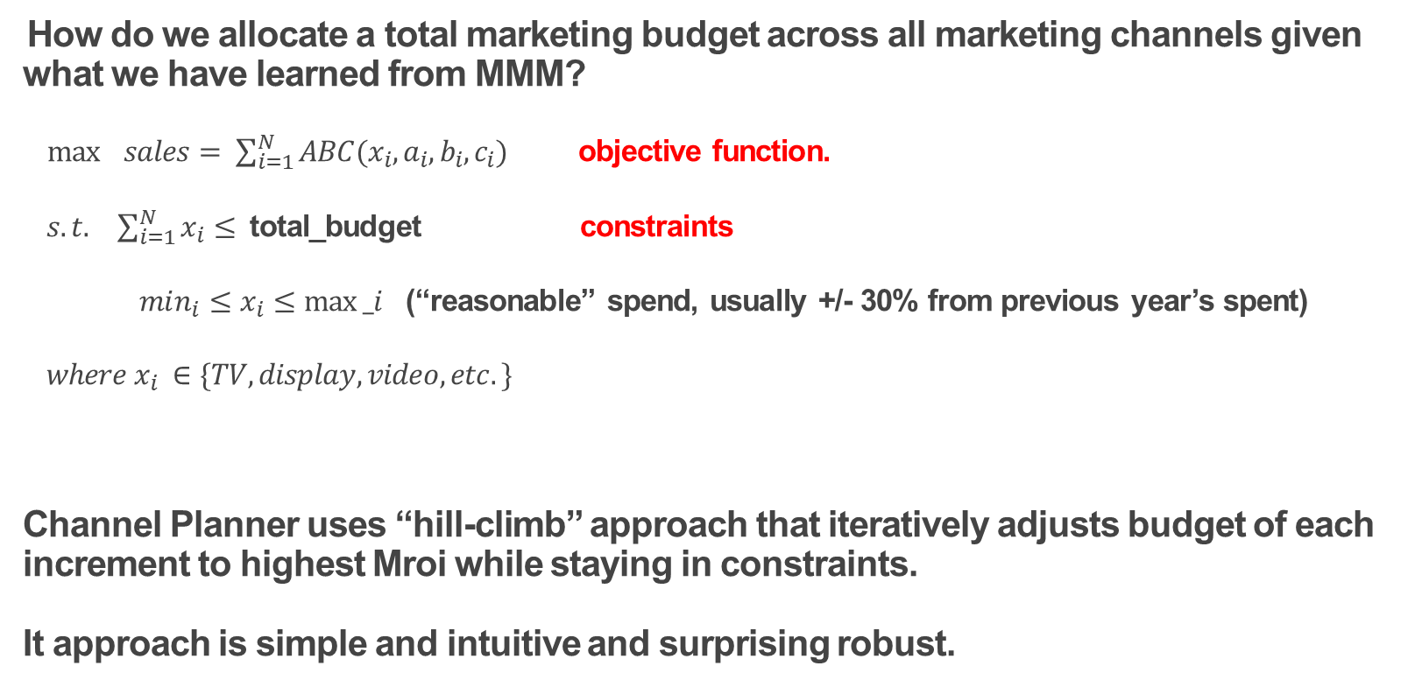
Optimization/Budget allocation - Channel Planner
How do we allocate a total marketing budget across all marketing channels given what we have learned from MMM?
$\max{ sales= \sum_{i=1}^{N}{ABC(x_{i}, a_{i}, b_{i}, c_{i})}}$ objective function.
$s.t. \sum_{i=1}^{N}{x_{i}}≤$ total_budget constraints
$min_{i}{≤x_{i}≤max⁡_i}$ (“reasonable” spend, usually +/- 30% from previous year’s spent)
$where x_{i} ∈\{TV, display, video, etc.\}$
Channel Planner uses “hill-climb” approach that iteratively adjusts budget of each increment to highest Mroi while staying in constraints.
It approach is simple and intuitive and surprising robust.

Slide 18
The codebase also allows network of models that represents purchase funnel or how consumer metrics influence sales. For example, Bacardi Purchase Funnel consists of Familiarity and Sentiment driving Desire which ultimately drives Sales
Familiarity
Long Term Familiarity + Advertising + PR/Events
Sentiment
Long Term Sentiment + Advertising + PR/Events
Desire
Long Term Desire + Familiarity + Sentiment + Advertising + PR/Events
Sales
Base + Desire + Promotion + Distribution +
Price +Advertising + PR/Events + Competitors

Slide 19
Toy example of nested models
sales ~ base + tv + display + search
Parent Model Eq.
search
Search is the link between models
search ~ base + tv + display
Child Model Eq.
Unnest decomp
Media Direct effect to sales 7%
Media Spend
Media Indirect contribution through search 3%
sales
Total contribution is 10%
Media Direct effect to search 30%
search
Search contribution 10% to sales

Slide 20
Why Bayes?

Slide 21
Challenges in MMM
Classical regression works great with
Aggregated data
Data that has no serious multi-collinearity
The realities:
Multi-collinearity : TV and digital are excuted the same time -> unreliable and unstable estimates.
More granular estimates of marketing channels -> Degree of freedom -> too many predictors -> over-fitting and poor predictions
More granular estimates at regional level -> sparse data -> unreliable estimates
Model with short time period
Missing variable biases
Notes:
Data is messy : dis-aggregated, missing data, almost never come from a controlled randomized experiments.

Slide 22
How can we use Bayesian?
The msmp framework uses Bayesian regression.
Bayesian framework allows incorporation of prior knowledge (from previous models, matched market test, domain experts knowledge, etc.).
We are allowed to incorporate prior information about the parameter, which is then updated by collected data… the posterior distribution (the result) from the previous model can then become prior for the next model… this process is just like human learning process -> far more intuitive.
The Bayesian framework fits marketing analytics much better :
Marketing managers (subject experts) usually have a sense of how marketing response are. This knowledge can be expressed in math form and incorporated into the model. If no prior information, the prior distribution can be expressed as a uniform distribution or a normal distribution with a huge variance.
Models are usually done semi-annually or annually, no need to start from scratch.
The essence of Bayesian statistics is the combination of information from multiple sources and fully accounting uncertainty using probability distributions and regularize estimations proportionally according to group-level and individual-level information – hierarchical Bayesian model.
Notes:
Data is messy : dis-aggregated, missing data, almost never come from a controlled randomized experiments.

Slide 23
FAQ : choice of prior
In the msmp framework, the prior of the model parameters are assumed to have gaussian distribution -> conjugate prior, Markov Chain Monte Carlo is not needed.
the default priors are diffuse/flat. In other words, normal distribution with mean of zero and standard deviation of 1 billion. The Bayesian regression result defaults to OLS result with such priors.
I recommend start with diffuse priors if you are building a model for a client/category for the first time.
Use informative priors (based on previous model results) during a model refresh.
If the data is panel style, geo or categories, hierarchical Bayesian model (partial pooling) can be built to account for
We have also split the variable (say total TV) to

Slide 24
Appendix

Slide 25
Bayesian regression
The Model
or

Slide 26
Bayesian inference (1st step)
Priors
(assumption)
Notes:
A Bayesian will first write out his/her priors

Slide 27
Bayesian inference (2nd step)
Likelihood : a frequentist takes this step only
Notes:
The common step with the frequentist

Slide 28
Bayesian inference (the 3rd step)

Slide 29
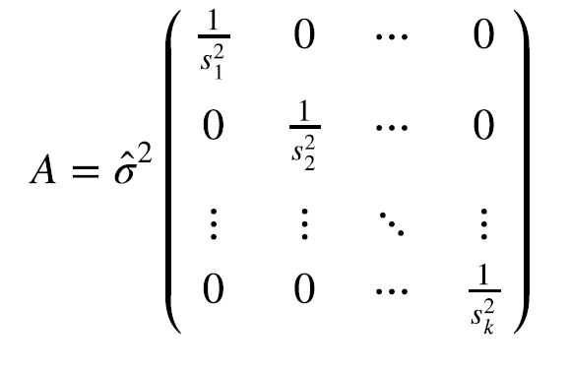
Calculate posterior without using MCMC
First estimate model error σ from data.
Then given the estimated σ, β can be calculated by augmenting data with prior, then estimating just like OLS.
It is much more robust, scalable, and fast.
Suitable for model with aggregated data, where model error can be assumed normally distributed.
Not suitable for individual-level data.
Notes:
This is math behind our implementation in Annalect R code.

Slide 30
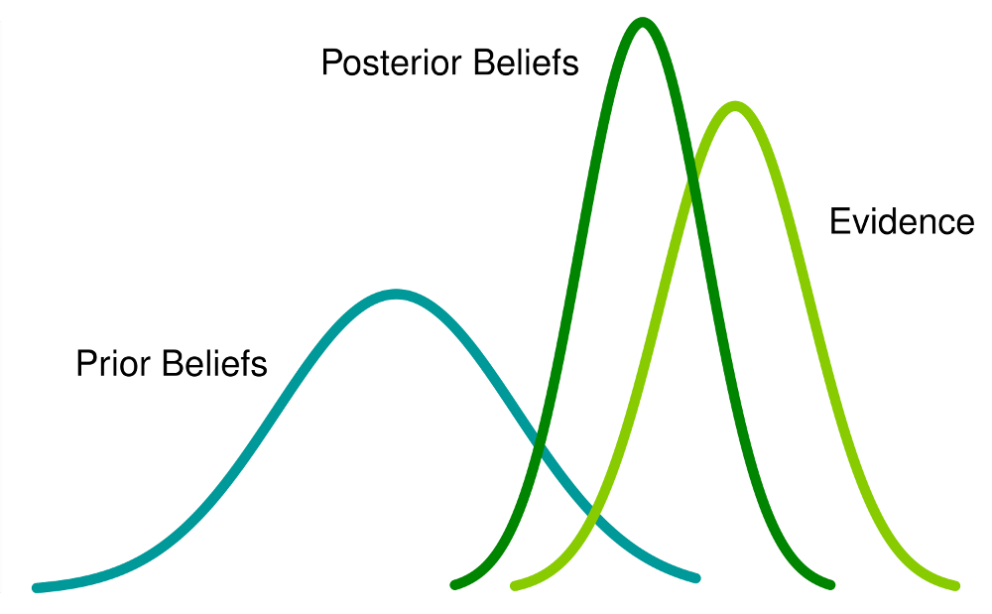
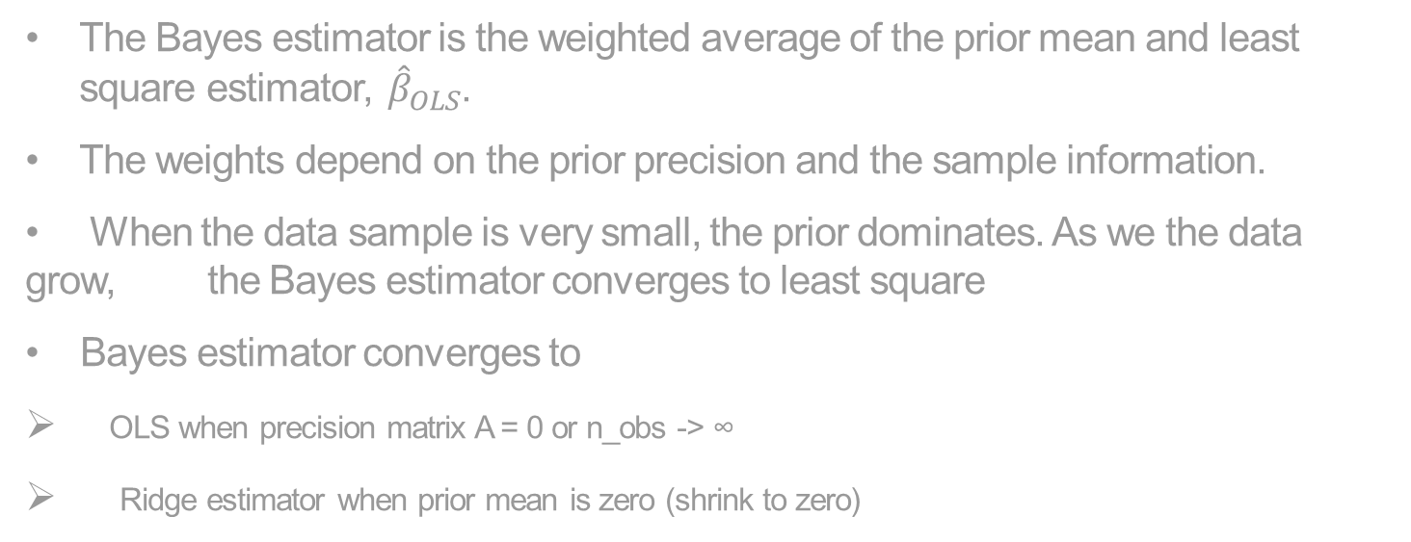

Bayesian regression estimator with conjugate priors
The Bayesian result of β is a Gaussian distribution with :
Mean:
Variance:
The Bayes estimator is the weighted average of the prior mean and least square estimator, ${\hat{β}}_{OLS}$.
The weights depend on the prior precision and the sample information.
When the data sample is very small, the prior dominates. As we the data grow, the Bayes estimator converges to least square
Bayes estimator converges to
OLS when precision matrix A = 0 or n_obs -> ∞
Ridge estimator when prior mean is zero (shrink to zero)
OLS estimator:
$${\left|\left|y −Xβ\right|\right|}^{2}$$
$$β_ols={\left(X^{′}X\right)}^{−1}X^{′}y$$

Slide 31
FAQ : choice of prior
In the msmp framework, the prior of the model parameters are assumed to have gaussian distribution -> conjugate prior, Markov Chain Monte Carlo is not needed.
the default priors are diffuse/flat. In other words, normal distribution with mean of zero and standard deviation of 1 billion. The Bayesian regression result defaults to OLS result with such priors.
I recommend start with diffuse priors if you are building a model for a client/category for the first time.
Use informative priors (based on previous model results) during a model refresh.
If the data is panel style, geo or categories, hierarchical Bayesian model (partial pooling) can be built to account for
We have also split the variable (say total TV) to

Slide 32
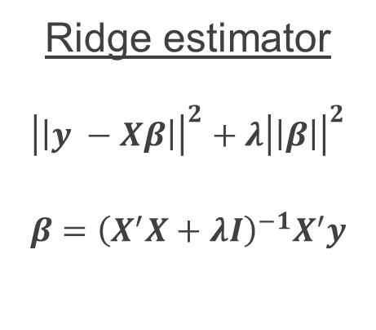

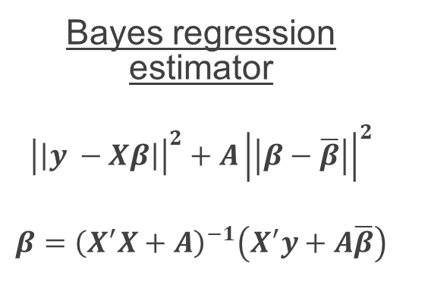
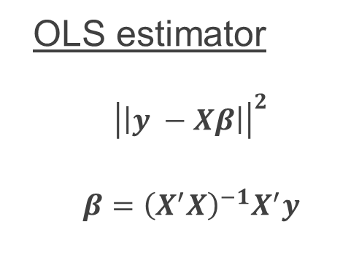
Connection to other (regularized/shrinkage) estimators
OLS estimator
$${\left|\left|y −Xβ\right|\right|}^{2}$$
$$β={\left(X^{′}X\right)}^{−1}X^{′}y$$
Ridge estimator
$${\left|\left|y −Xβ\right|\right|}^{2}+λ{\left|\left|β\right|\right|}^{2}$$
$$β={\left(X^{′}X+λI\right)}^{−1}X^{′}y$$
Bayes regression estimator
$${\left|\left|y −Xβ\right|\right|}^{2}+A{\left|\left|β−\overline{β}\right|\right|}^{2}$$
$$β={\left(X^{′}X+A\right)}^{−1}\left(X^{′}y+A\overline{β}\right)$$
Lasso regression : ${\left|\left|y −Xβ\right|\right|}^{2}+λ|\left|β\right||$
Stein estimator: same idea as empirical Bayes, where estimator for each individual unit is weighted average of grand mean and data of each individual. We will discuss empirical Bayes and hierarchal Bayes at another time.

Slide 33
Thank you!

